Slide 1
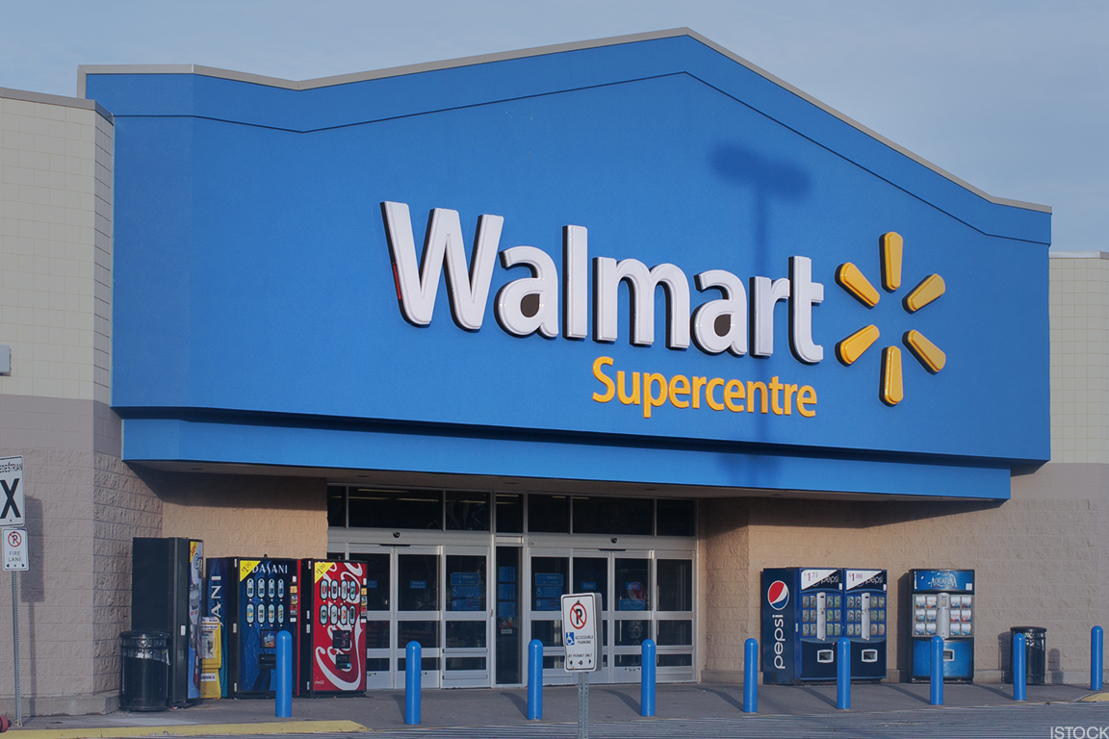
Yuha Yi
University of Idaho
Fall 2018 – Stats 517

Slide 2
Objective
Predict sales for each store by week
Four years of data from 2010-2013
Prepare for certain Holidays
Allocate workers for certain amount of hours during slow or busy weeks
Estimate income

Slide 3
Data
Store - the store number
Date - the week
Temperature - average temperature in the region
Fuel_Price - cost of fuel in the region
MarkDown1-5 - anonymized data related to promotional markdowns that Walmart is running
CPI - the consumer price index
Unemployment - the unemployment rate
IsHoliday - whether the week is a special holiday week

Slide 4
Data
Weekly_Sales – Sales for the given department in the given store
Given Holidays
Super Bowl: 12-Feb-10, 11-Feb-11, 10-Feb-12, 8-Feb-13 Labor Day: 10-Sep-10, 9-Sep-11, 7-Sep-12, 6-Sep-13 Thanksgiving: 26-Nov-10, 25-Nov-11, 23-Nov-12, 29-Nov-13 Christmas: 31-Dec-10, 30-Dec-11, 28-Dec-12, 27-Dec-13

Slide 5
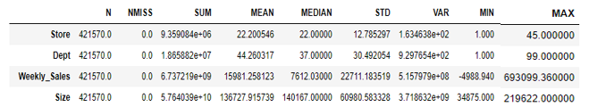
Exploratory Data

Slide 6
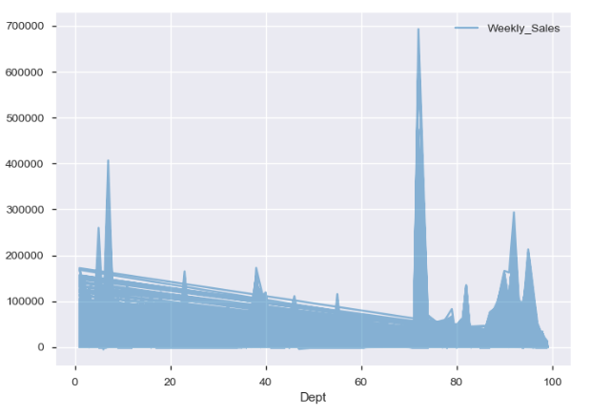
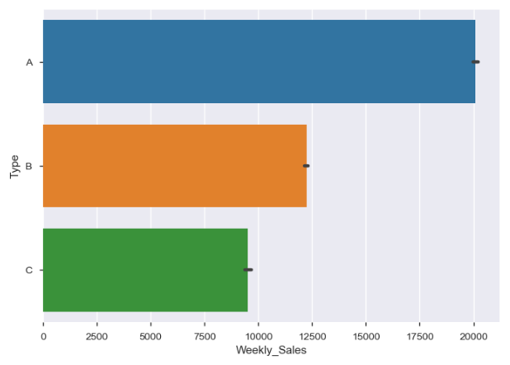
Exploratory Data

Slide 7
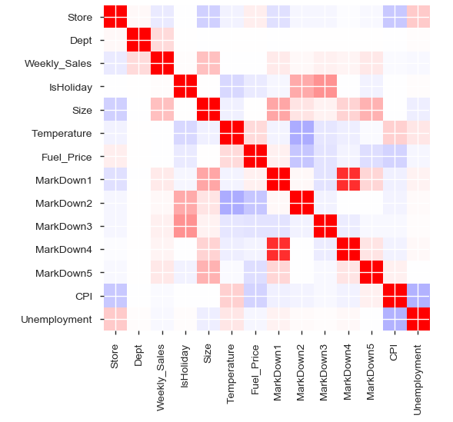
Exploratory Data

Slide 8
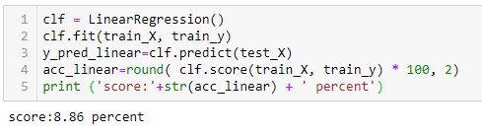
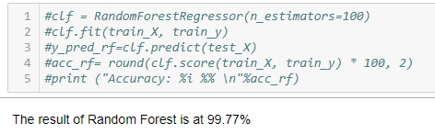
Supervised Learning - Regression

Slide 9
In the Works – Unsupervised Learning
Cluster the holidays, observe their relation to weekly_sales
Which holiday does best?
Which markdown is relevant for which holiday
Cluster Departments with holidays
Which department is popular during which holiday?

